Slide 1

Wednesday, 24th May
PRESENTED BY
Final Year Project
Shivanshu Singh
Ayush Tah
Storage and Organisation of Geospatial Data on a distributed Blockchain using IPFS

Slide 2
Overview
Rapid advances in technology have led to an unprecedented amount of geospatial data.
Ensuring data privacy, integrity, and security is challenging due to different formats and standards.
Data reformatting and scrubbing are necessary before any comparison, combination, or mapping can occur.
Blockchain technology is a potential solution due to its tamper-proof, traceable, trust-free, transparent, and decentralized characteristics.
A method for storing and accessing geospatial data using blockchain and IPFS has been proposed.
The proposed method has been tested on three datasets and proven to be efficient, secure, and immutable.
The proposed method has been compared to state-of-the-art centralized storage solutions.

Slide 3
Table of
Contents
Page
I
Introduction
4
II
Background and Motivation
6
III
Is IPFS the right solution?
11
IV
Methodology
13
V
Results, Conclusion & Discussions
16

Slide 4

I
Introduction
Blockchain technology has potential applications in several domains, including healthcare, finance, and supply chain management.
The Indian Space Research Organisation (ISRO) has identified the need for a more effective method of storing geospatial data, as stated in the Smart India Hackathon (SIH) problem statement.
Blockchain technology can provide security and ensure data integrity, making it a suitable solution for storing geospatial data.
4

Slide 5
I
Introduction
IPFS, a distributed file system, can be utilized to store geospatial data in a secure and accessible manner.
IPFS identifies files by their content, enabling data to be easily accessed from any node on the network, without the need for a central authority.
IPFS offers a secure and reliable method for storing geospatial data, making it a promising option for ISRO's needs.
5

Slide 6



II
Background & Motivation
Blockchain
Blockchain technology is a secure and decentralized system that uses cryptography to protect a list of records called blocks. This technology was initially introduced in 2008 as a public ledger for Bitcoin transactions. It is a revolutionary system that has gained significant attention due to its security and decentralization features. This technology operates by using cryptographic techniques to secure a list of records known as blocks. The blocks are linked together in a chain-like structure, thus forming a blockchain.
6

Slide 7
II
Background & Motivation
Blockchain
Here are some key features of Blockchain technology:
Peer-to-peer network: Blockchain management occurs through a peer-to-peer network of computers that communicate with each other to maintain a shared database.
Consensus Algorithm: The peer-to-peer network uses a consensus algorithm to validate new transaction blocks before adding them to the blockchain.
Security: Blockchain records are designed with security as a primary consideration and have a resilient fault tolerance mechanism.
Genesis Block: The first block in a blockchain is the "Genesis Block" and does not have any prior hash.
Cryptographic Linking: Subsequent blocks contain a previous hash and are cryptographically linked to the previous block in the chain.
7

Slide 8
II
Background
InterPlanatary File System
IThe InterPlanetary File System (IPFS) is an innovative distributed file system and hypermedia protocol that represents a significant departure from traditional centralized approaches to data storage and retrieval. At the core of IPFS is a novel mechanism for uniquely identifying files, known as content-addressing, which allows for seamless and secure sharing of files across the network without reliance on a central authority.
8

Slide 9
II
Background
InterPlanatary File System
This system has the following features:
Unique Content Identifier (CID): Each uploaded file receives a unique Content Identifier (CID) derived from its content's hash. CID allows for fast and secure retrieval of files, and minimizes data redundancy.
Decentralized Hash Table (DHT): IPFS operates as a decentralized hash table (DHT) that associates CIDs with users possessing the corresponding content. This enables content to be distributed across the network and eliminates the need for a central server.
Support for Multiple Files and Directories: CID supports uploading of multiple files and creation of directories, making it easy to organize and manage large collections of data.
Speed and Reliability Benefits: IPFS offers speed and reliability benefits, with multiple users able to upload the same data, and downloads distributed among them. This ensures that content is always available, even if some nodes on the network are offline.
9

Slide 10
II
Background & Motivation
Motivation
The motivation behind this study was a problem statement presented by the Indian Space Research Organization (ISRO) on the Smart India Hackathon (SIH) platform. The statement highlighted the critical need for secure and scalable storage of geospatial data, which is constantly growing. The ISRO stressed the potential of blockchain-based technologies to provide strong byzantine fault tolerance and distributed data storage and access. However, a significant challenge is the lack of mature options for storing and organizing large geospatial datasets on a distributed blockchain. The novelty and complexity of this subject provided a compelling incentive for our research team to investigate this area, with the primary goal of acquiring new knowledge and skills.
10

Slide 11
III
Is IPFS the right solution?
Sequential file retrieval from a single server using HTTP is inefficient and costly.
IPFS utilizes a peer-to-peer network architecture, allowing for concurrent retrieval of data segments from multiple nodes, reducing bandwidth consumption by up to 60% for video content.
IPFS enables efficient dissemination of voluminous data without redundancy.
Web pages have a limited lifespan of only around 100 days, making them unsuitable for preserving human history.
IPFS offers a resilient network for data mirroring and content addressing, ensuring automatic versioning of stored files.
The current web infrastructure is centralized, limiting opportunities and jeopardizing the internet's role in promoting innovation.
11

Slide 12
III
Is IPFS the right solution?
IPFS upholds the concept of an open and decentralized web, providing the necessary technology to realize this vision.
IPFS offers an alternative to the internet backbone by enabling the creation of diverse and robust networks that guarantee accessibility even without internet backbone connectivity.
This feature enhances connectivity, especially in developing countries, during natural disasters or while utilizing unreliable Wi-Fi services in coffee shops.
12

Slide 13


IV
Methodology
The proposed application uses the Express.js framework, which comprises several libraries and functions working in collaboration.
The ipfs-http-client library is used to create an IPFS instance that connects to the IPFS daemon API, enabling the application to interact with the IPFS network and perform operations such as adding, retrieving, and deleting files.
The body-parser middleware extracts data from incoming request bodies and makes it available to the handler.
Express-fileupload middleware simplifies file uploads by handling file transfer, validation, and storage.
13

Slide 14
IV
Methodology
The fs module is used to read and write data from and to files in the file system.
The express-session middleware manages user sessions by storing session data such as login state or user preferences.
The bcrypt library is used for secure password hashing and is employed in this application to store user passwords securely.
The getipfsClient function returns an IPFS instance and is used to create a new IPFS instance whenever one is required.
The app instance of the Express.js application is responsible for handling requests and responses.
The app.set method is used to set the view engine to use Embedded JavaScript (EJS) as the template engine, allowing the application to render dynamic HTML pages.
The app.use method is used to mount middleware functions to the Express.js application, which can modify the request or response before the handler.
The userDataFile variable holds the name of the file that stores user data and is used in conjunction with fs to read and write user data.
14

Slide 15
IV
Methodology
The readUserData function reads user data from the file system and returns it as an array of objects, while the writeUserData function writes user data to the file system.
The app.get and app.post methods are used to handle GET and POST requests, respectively, to retrieve or send data to the server.
The req.session object stores session data for the current user.
The app.listen method is used to start the Express.js server on the specified port
15

Slide 16
V
Results
The code underwent testing using up to 1000 TIFF files obtained from various sources, including VEDAS, Bhuvan, and Kaggle datasets.
The user interfaces are illustrated in the upcoming screenshots.
When uploading and downloading, the hash values of all files were compared, and the results are presented..
The analysis revealed that all uploaded files' data remained unchanged after they were broken down into fragments and arranged into Merkle DAG for IPFS storage.
The hash value represents the unique identifier generated when the file is added to IPFS.
The time taken for the file to be uploaded, downloaded, and compared against the original hash is referred to as latency.
In terms of accuracy, the results can only be 0% or 100%, indicating either the file has been downloaded with the same hash or not because the hash value has changed, or the file is missing, which is unlikely.
16

Slide 17
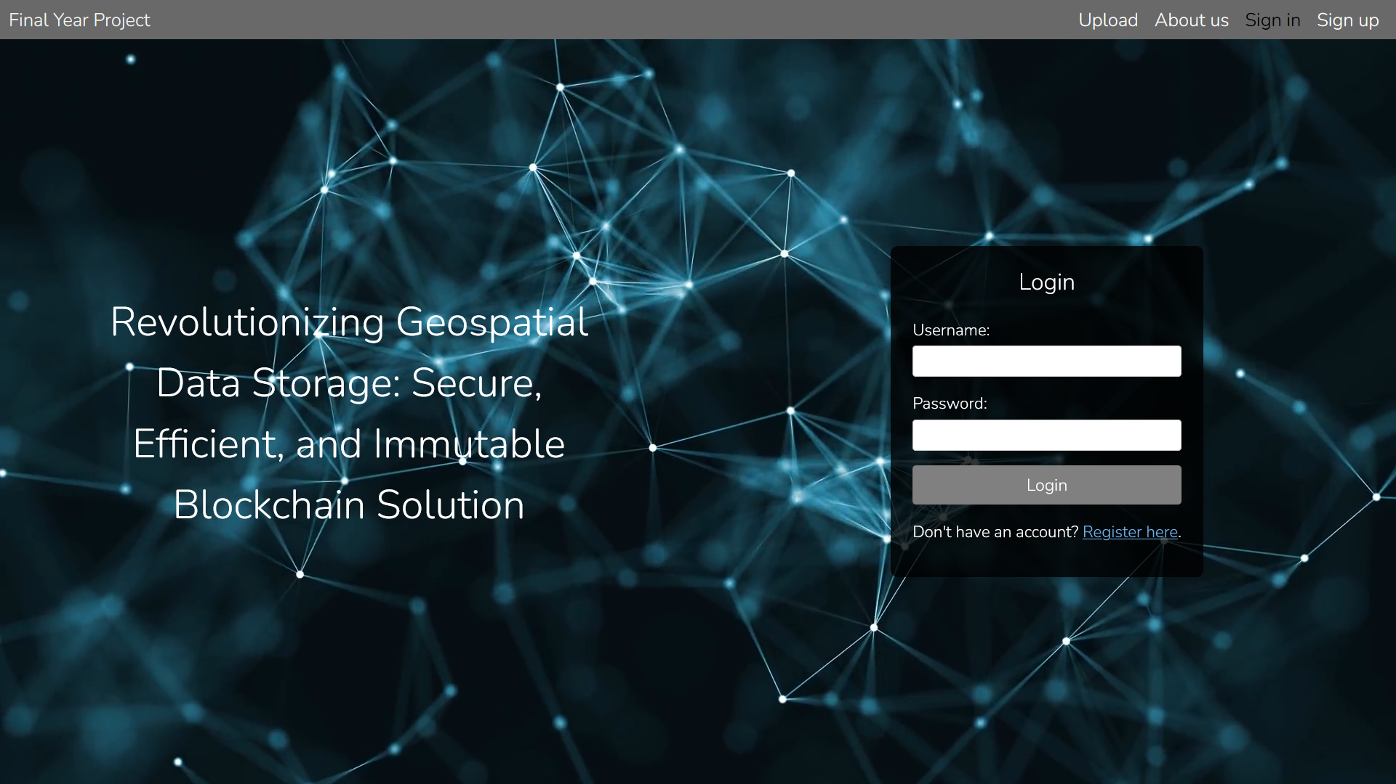
V
Results
17

Slide 18
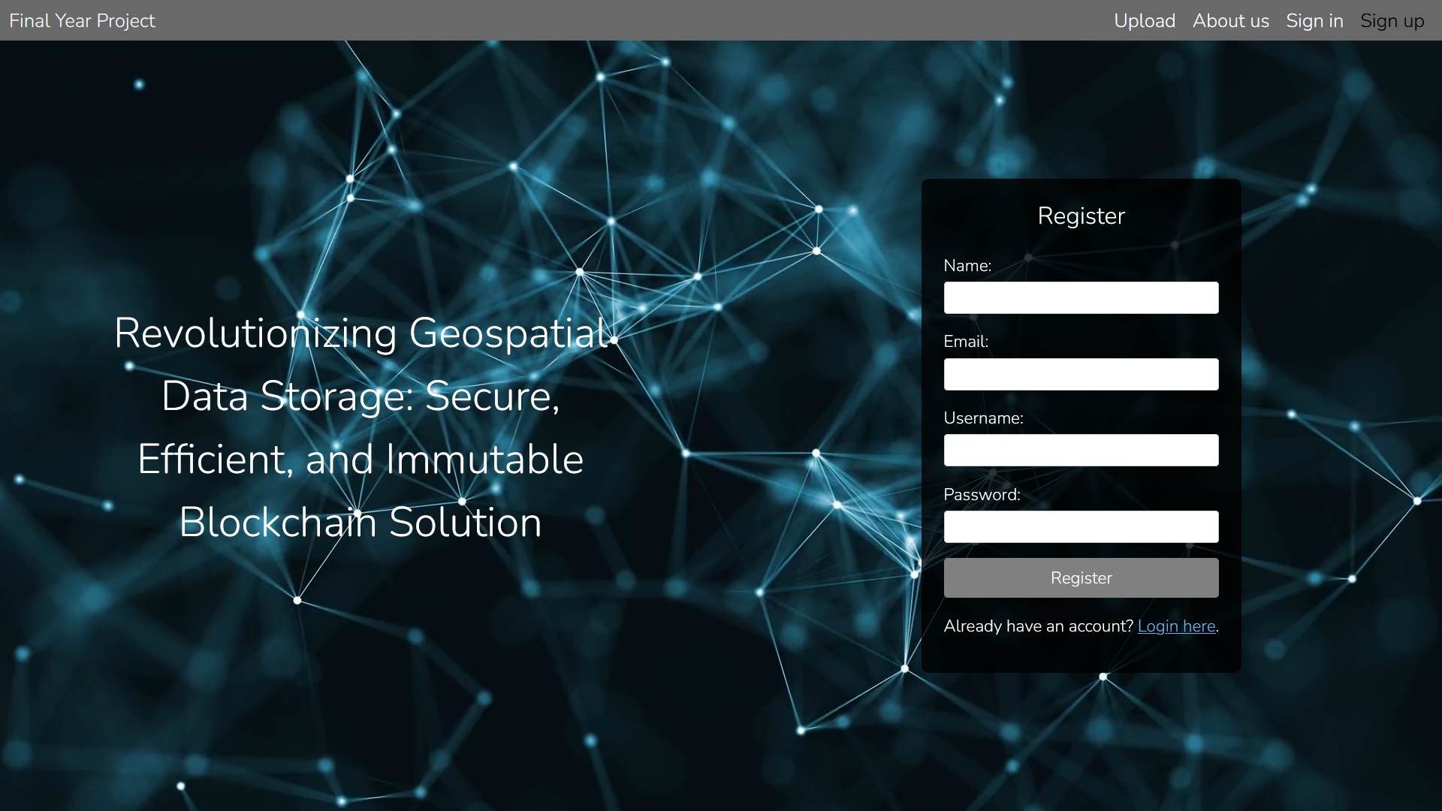
V
Results
18

Slide 19
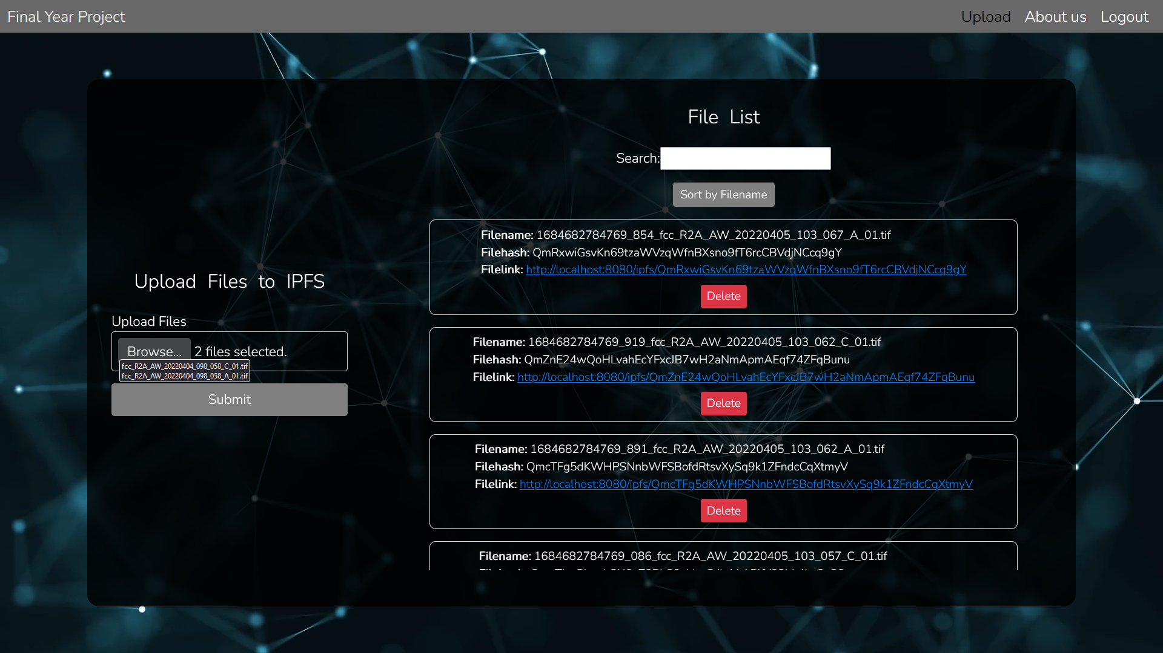
V
Results
19

Slide 20
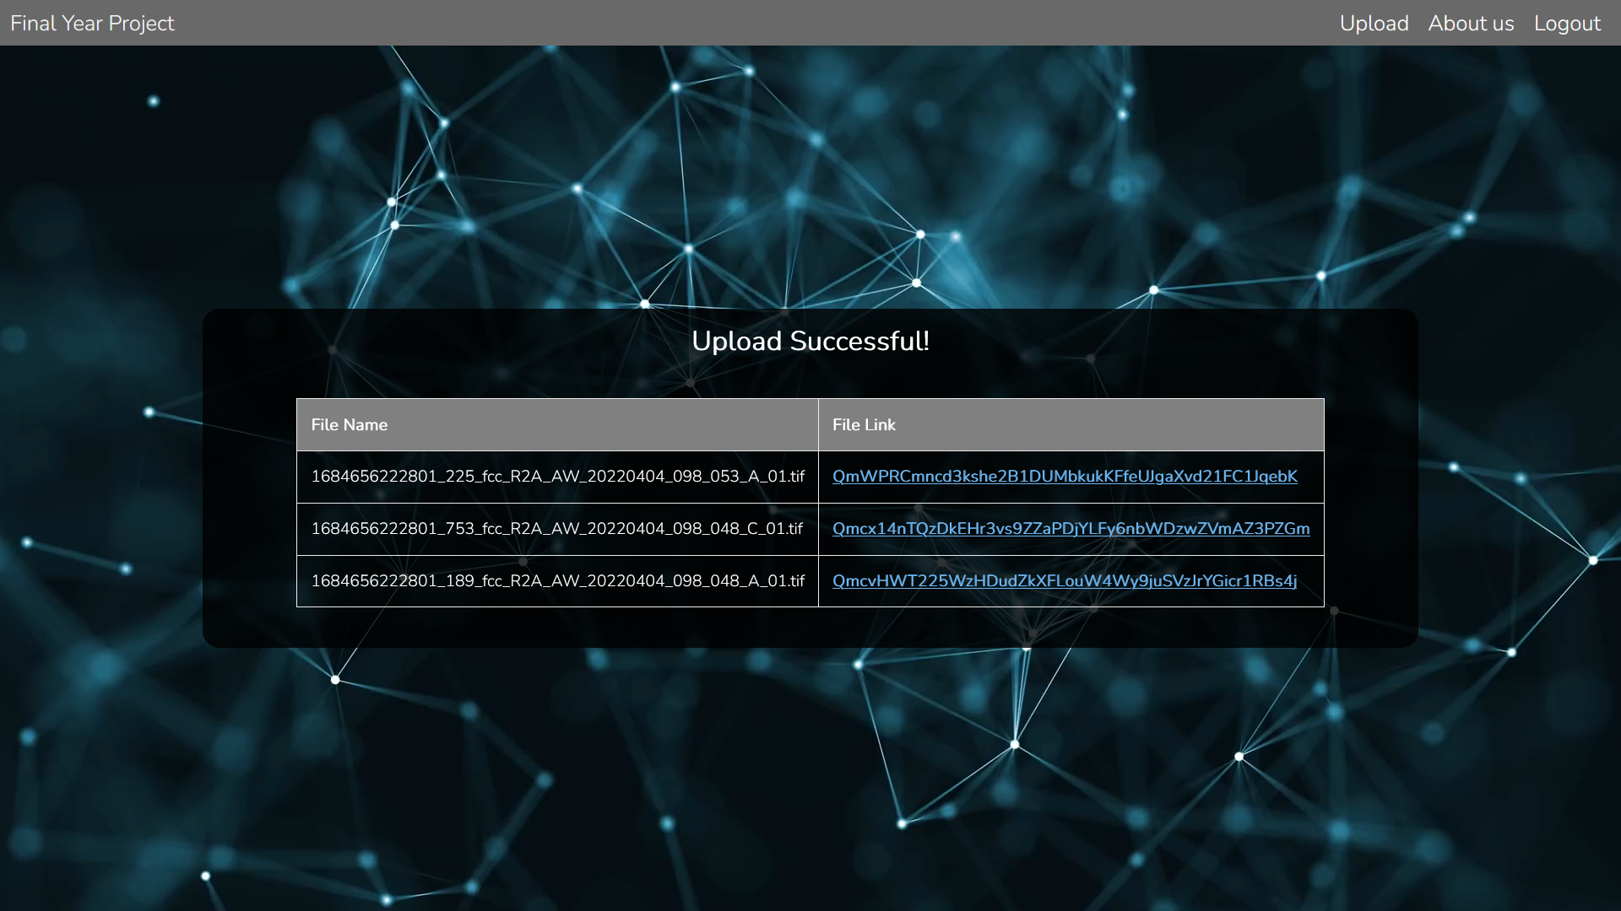
V
Results
20

Slide 21
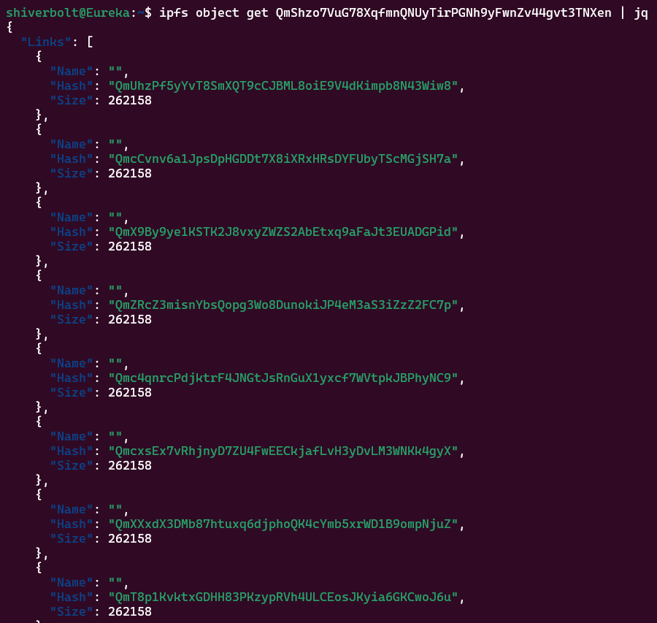
V
Results
Here we are employing the "ipfs object get <hash>| jq" command to retrieve the Merkle Directed Acyclic Graph (DAG) for the designated object, consisting of the hashes of all constituent blocks and their interlinkages. The resulting information is encoded in the JavaScript Object Notation (JSON) format, which is subsequently displayed by the jq command.
It is noteworthy that the various hashes generated by the "ipfs object get <hash> | jq" command refer to the individual blocks comprising the IPFS object, as well as the root node of the Merkle DAG. These hashes, although not directly related to the initial file that was partitioned during upload, serve as essential markers for identifying and retrieving the content of the file from the IPFS network.
21

Slide 22
V
Conclusion
Benefits of IPFS for Geospatial Data Storage:
Optimizes storage utilization by addressing content by its unique hash rather than its location, allowing for efficient sharing of data across nodes.
Minimizes fragmentation by creating a directed acyclic graph (DAG) that stores data as linked blocks, reducing the likelihood of data loss due to system crashes or errors.
Ensures redundancy by creating multiple copies of data blocks across nodes, improving data availability and reliability.
Offers a feasible, reliable, secure, and highly scalable approach for storing and organizing geospatial data via a distributed blockchain.
22

Slide 23
V
Conclusion
Considerations for Full-Scale Implementation:
A full-scale implementation of IPFS for geospatial data storage may experience variations in accuracy and performance depending on the variables.
However, these discrepancies are not expected to be significant.
Therefore, the utilization of IPFS for geospatial data storage is a promising solution for organizations looking to improve their data storage and management processes.
23

Slide 24
V
Discussions
Q & A

Slide 25
Thank you
for listening!

